Slide 1

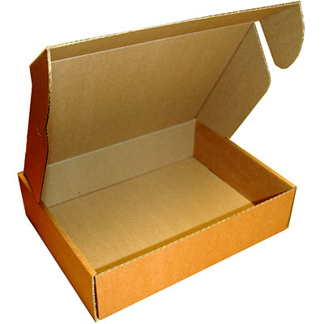
13. Packaging a Game
Let’s Learn
Aj. Andrew Davison, CoE, PSU Hat Yai Campus
E-mail: ad@fivedots.coe.psu.ac.th

Slide 2
Outline
What does Packaging Mean?
cx_Freeze
The Invaders Game Again
setup.py for Invaders

Slide 3

1. What does Packaging Mean?
1. Create an executable (.exe) file for your game, which the user only has to double-click on to start
no need to download & install python
no need to start IDLE or run python from the command prompt
2. Create an installer (.msi) file for your game which installs the executable automatically
the player only has to download a single MSI file from you

Slide 4
2. cx_Freeze
The cx_Freeze package can convert a Pygame program into an executable, and also an installer.
Website: https://sourceforge.net/projects/cx-freeze/
Docs: http://cx-freeze.readthedocs.io/en/ latest/overview.html
Mailing list: https://sourceforge.net/p/cx-freeze/ mailman/cx-freeze-users/
But, for Python 3.5 on Windows, you need cx_freeze v5.0 at:
https://github.com/sekrause/cx_Freeze-Wheels

Slide 5
Installing cx_Freeze
Download the wheel file (.whl) for 32-bit or 64-bit Python (look back at part 2)
e.g. cx_Freeze-5.0-cp35-cp35m-win32.whl
Install it into Python using pip:
pip install cx_Freeze-5.0-cp35-cp35m-win32.whl

Slide 6
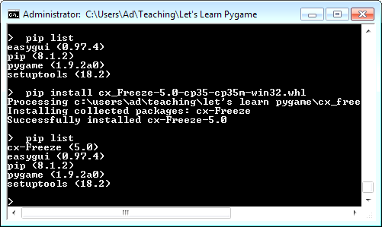

Slide 7
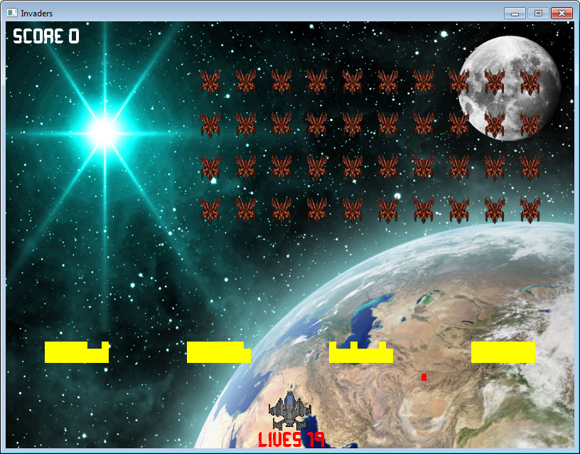
3. The Invaders Game Again
Use cx_Freeze to create an executable and installer for the Invaders game.

Slide 8
Create a setup.py File
cx_Freeze uses a setup.py file to combine all of the game parts (code, images, music, fonts), pygame, and python into an executable
you must write setup.py
The contents of setup.py can vary a lot depending on what python modules you are using
use my setup.py in the Invaders/ folder as a starting point for your own games

Slide 9
Using setup.py
python setup.py build
this creates the executable
it prints lots of information and error messages
python setup.py bdist_msi
this creates the installer from the executable

Slide 10
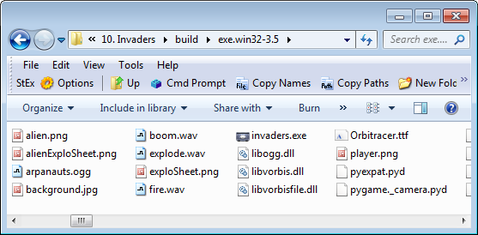
Building the Executable
The "build" command creates a build/ folder, which contains an executable folder called exe.win32-3.5/
In the executable folder is invaders.exe
Double
click to
run game

Slide 11
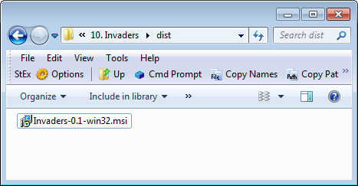
Building the Installer
The "bdist_msi" command creates a dist/ folder, which contains the installer file called Invaders-0.1-win32.msi
Send only this file to a user
Double-click to install the invaders executable.

Slide 12
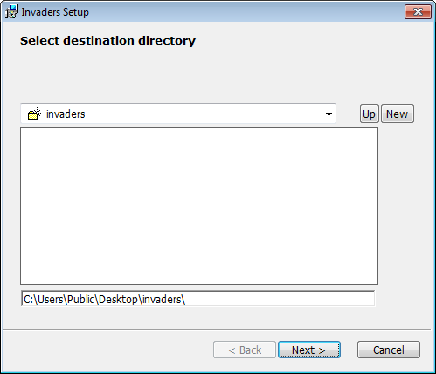
Installing the Game
Double-click on the MSI file. It asks where to install the invaders/ folder, and then takes 10-30 secs to install it.

Slide 13
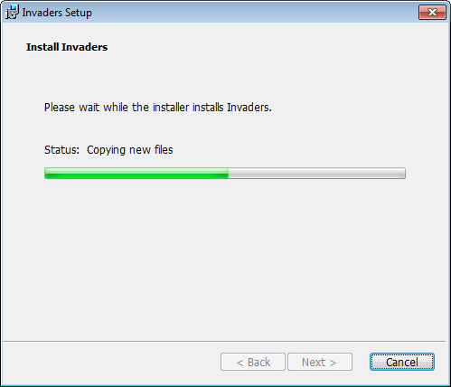

Slide 14
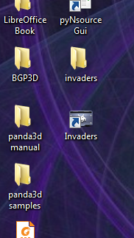
The invaders/ folder is installed on the desktop, and a shortcut to the executable is also added to the desktop.
Double
click to
run game

Slide 15
Uninstalling the Game
There is no uninstaller feature.
But the user can easily uninstall the game by deleting the invaders/ folder and shortcut

Slide 16
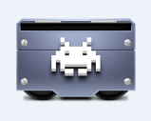
4. setup.py for Invaders
The "build" parts of setup.py:
from cx_Freeze import setup, Executable
import os
pygamePath = os.environ['LOCALAPPDATA'] + \
"\\Programs\\Python\\Python35-32\\Lib\\site-packages\\pygame\\"
target = Executable(
script = "invaders.py",
base = 'Win32GUI',
icon = "Apathae-Satellite-2-Games.ico", # from http://www.iconarchive.com/
)
Change this to match your game.

Slide 17
setup(
name="Invaders",
author = "Andrew Davison",
version = "0.1",
description = "Simple Space Invaders clone",
options={
"build_exe": { # build_exe_options
"packages":["pygame"],
"excludes": ["tkinter", "tcl", "numpy"],
"silent": True,
"include_files":["Orbitracer.ttf",
"startScreen.jpg", "background.jpg",
"player.png", "alien.png",
"alienExploSheet.png", "exploSheet.png",
"arpanauts.ogg",
"boom.wav", "explode.wav", "fire.wav",
(pygamePath+"libogg.dll", "libogg.dll"),
(pygamePath+"libvorbis.dll", "libvorbis.dll"),
(pygamePath+"libvorbisfile.dll", "libvorbisfile.dll"),
] # force cx_freeze to include OGG DLLs from Pygame
},
"bdist_msi": bdist_msi_options,
},
executables = [target]
)
Change this stuff
to match your game.
game fonts,
pictures, music, sounds
and 3 OGG DLLs

Slide 18
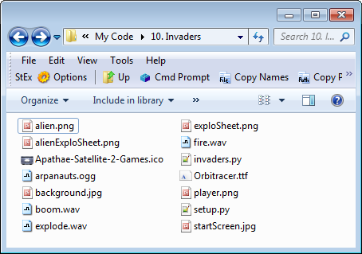
Folder Contents for Invaders
The 3 OGG DLLs
will be copied from
the Pygame
folder by cx_freeze

Slide 19
The "bdist_msi" parts of setup.py:
shortcut_table = [
("Invaders", # Shortcut
"DesktopFolder", # Directory_
"Invaders", # Name
"TARGETDIR", # Component_
"[TARGETDIR]\invaders.exe",# Target
None, # Arguments
None, # Description
None, # Hotkey
None, # Icon
None, # IconIndex
None, # ShowCmd
"TARGETDIR", # WkDir
)
]
msi_data = {"Shortcut": shortcut_table}
bdist_msi_options = {'initial_target_dir':
r'[DesktopFolder]\invaders',
'data': msi_data}
For creating the invaders.exe shortcut
For creating the
invaders/ executable folder
on the desktop

